Slide 1
1. Download anaconda
wget https://repo.anaconda.com/archive/Anaconda3-2024.10-1-Linux-aarch64.sh
wget is the command to download file from web

Slide 2
2. Copy file to device(Raspberrypi)
scp Anaconda3-2024.10-1-Linux-aarch64.sh pi@169.254.68.27
Copy anaconda file we downloaded raspberrypi by using scp command

Slide 3
3. Install anaconda in jetson nano and activate it
ssh -o PreferredAuthentications=password -o PubkeyAuthentication=no pi@169.254.68.27
By using ssh command, we can log in device, which has that address
chmod +x Anaconda3-2024.10-1-Linux-aarch64.sh
To execute anaconda installation file, we give the permission of it first by changing mode +x
./Anaconda3-2024.10-1-Linux-aarch64.sh
Execute file. And then type “q” to skip the document and proceed installing
source anaconda3/bin/activate
Activate anaconda

Slide 4
4. Train model using a variety of algorithm
import pandas as pd import numpy as np from sklearn.model_selection import train_test_split from sklearn.preprocessing import StandardScaler from sklearn.ensemble import RandomForestClassifier from sklearn.linear_model import LogisticRegression from sklearn.neighbors import KNeighborsClassifier from sklearn.neural_network import MLPClassifier from sklearn.metrics import classification_report import joblib
Import library/ joblib -> scalers and save model
column_names = ['class', 'alcohol', 'malic_acid', 'ash', 'alcalinity_of_ash', 'magnesium', 'total_phenols', 'flavanoids', 'nonflavanoid_phenols', 'proanthocyanins', 'color_intensity', 'hue', 'od280/od315_of_diluted_wines', 'proline']
Set column matrix corresponded name to our csv data
data = pd.read_csv('wine.data', names=column_names)
Load file named ‘wine.data’ and assign column names

Slide 5
4. Train model using a variety of algorithm(cont.)
X = data.drop('class', axis=1) y = data['class']
X is input data,which includes all columns except class,y is label, which only has class column
X_train, X_test, y_train, y_test = train_test_split(X, y, test_size=0.2, random_state=42)
Split the dataset into 80% training and 20% test data in both x,Y
scaler = StandardScaler() X_train_scaled = scaler.fit_transform(X_train) X_test_scaled = scaler.transform(X_test)
Standardize features to have 0 mean and 1 standard deviation.
def train_and_evaluate(model, model_name): model.fit(X_train_scaled, y_train)
We make function receiving model type and name for file name. and train the model
y_pred = model.predict(X_test_scaled)
Predict class using trained model for test data

Slide 6
4. Train model using a variety of algorithm(cont.)
report = classification_report(y_test, y_pred)
It assess model performance and save it as text file
filename = f"classification_report_{model_name}.txt"
Choose the filename to save
with open(filename, "w") as file: file.write(report)
Save file as writing mode
joblib.dump(model, f'{model_name}_model.joblib')
Save the trained model

Slide 7
4. Train model using a variety of algorithm(cont.)
rf_model = RandomForestClassifier(n_estimators=100, random_state=42) train_and_evaluate(rf_model, "random_forest")
Train and evaluates a random forest model with 100 trees in the forest
precision recall f1-score support
1.00 1.00 1.00 14
1.00 1.00 1.00 14
1.00 1.00 1.00 8
accuracy 1.00 36
macro avg 1.00 1.00 1.00 36
weighted avg 1.00 1.00 1.00 36

Slide 8
4. Train model using a variety of algorithm(cont.)
lr_model = LogisticRegression(random_state=42, max_iter=1000) train_and_evaluate(lr_model, "logistic_regression")
Train and evaluates a logistic regression model setting maximum iteration is 1000
precision recall f1-score support
1.00 1.00 1.00 14
1.00 1.00 1.00 14
1.00 1.00 1.00 8
accuracy 1.00 36
macro avg 1.00 1.00 1.00 36
weighted avg 1.00 1.00 1.00 36

Slide 9
4. Train model using a variety of algorithm(cont.)
knn_model = KNeighborsClassifier(n_neighbors=5) train_and_evaluate(knn_model, "knn")
Train and evaluates a K-Nearest Neighbors model with 5 neighbors
precision recall f1-score support
0.93 1.00 0.97 14
1.00 0.86 0.92 14
0.89 1.00 0.94 8
accuracy 0.94 36
macro avg 0.94 0.95 0.94 36
weighted avg 0.95 0.94 0.94 36

Slide 10
4. Train model using a variety of algorithm(cont.)
mlp_model = MLPClassifier(hidden_layer_sizes=(50, 50), max_iter=1000, random_state=42) train_and_evaluate(mlp_model, "neural_network")
Train and evaluates a Multi-Layer Perceptron model defining size of hidden layer and maximum iteration
precision recall f1-score support
1.00 1.00 1.00 14
1.00 1.00 1.00 14
1.00 1.00 1.00 8
accuracy 1.00 36
macro avg 1.00 1.00 1.00 36
weighted avg 1.00 1.00 1.00 36

Slide 11
Addiction
How to make python file
nano ”filename.py”
It creates python file name as “filename” and then put code
ctrl + shift + o and then x
It save files and then terminate python file
cat filename.py
Execute file

Slide 12
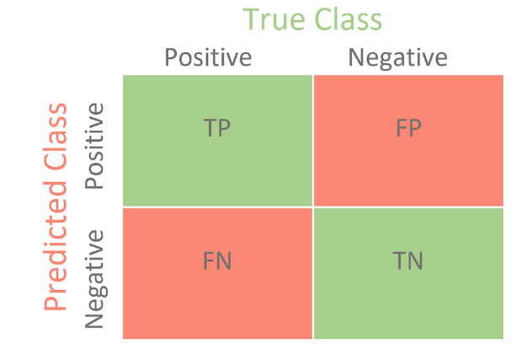
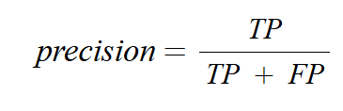

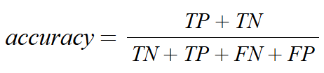
Addiction
Classification_report(y_true,y_pred)
it returns precision, recall, f1-socre using confusion Matrix. Parameters are label and our prediction values.

